Slide 3
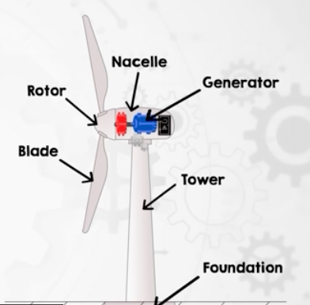
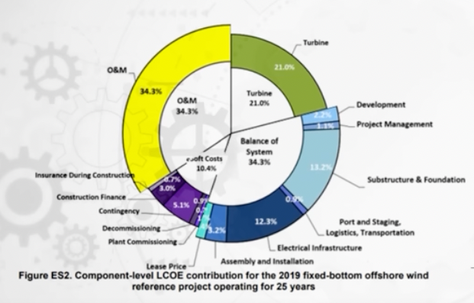
Main Non-turbine Costs
Main Turbine Components

Slide 4

Which size of wind turbines maximizes cost efficiency? A game of Tug-of-War
Team Small:
Structural Design Challenges
Team Big:
*Pretty much everything else. i.e.
Greater Swept Area
Fewer Electrical Connections
Less Maintenance
Simpler to Install

